Slide 1



Bootstrap 5
Chapter-2
The Next Generation of Web Development
Notes:
Hello everyone, welcome to AItrich Academy. Let's come back to our Bootstrap journey.

Slide 2
Bootstrap Grid system
The Bootstrap grid system is a powerful and responsive layout system that helps you create flexible and responsive web page layouts.
Bootstrap’s grid system uses a series of containers, rows, and columns to layout and align content.
It’s built with flexbox and is fully responsive.
Notes:
Bootstrap Grid System.
The Bootstrap grid system is a powerful and responsive layout system that helps you create flexible and responsive web page layouts.
Bootstrap’s grid system uses a series of containers, rows, and columns to layout and align content.It’s built with flexbox and is fully responsive.

Slide 3
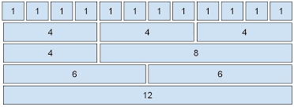
Grid Structure
The grid system is based on a 12-column layout.
A row is the container for columns.
Columns are defined using the .col-* classes, where * represents the number of columns the element should span.
Columns within a row should always add up to 12 or less to maintain a proper layout.
Notes:
Grid Structure
The grid system is based on a 12-column layout. A row is the container for columns. Columns are defined using the .col-* classes, where * represents the number of columns the element should span. Columns within a row should always add up to 12 or less to maintain a proper layout.

Slide 4
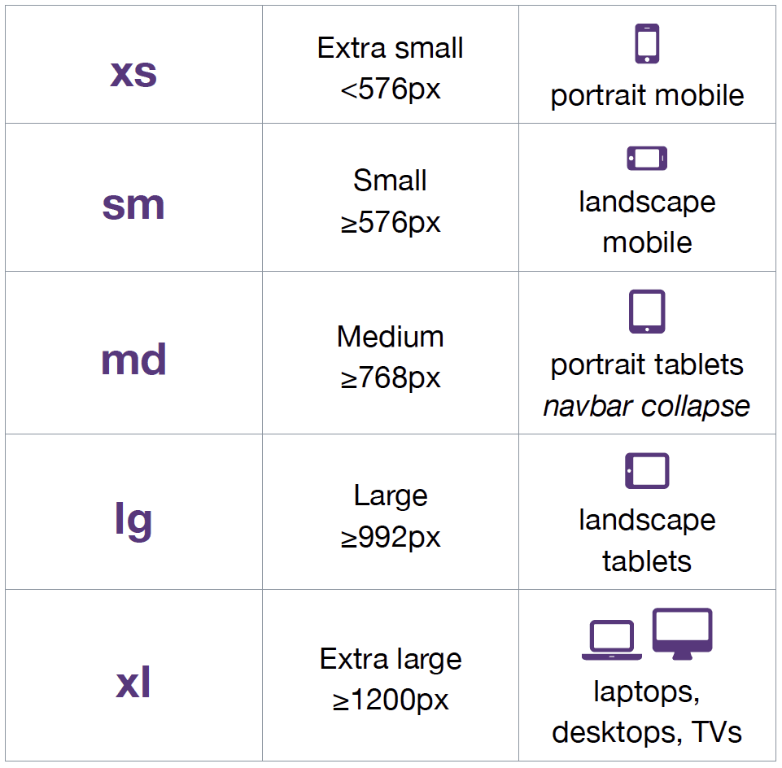
Grid classes
. xs (for phones - screens less than 768px wide)
.col-sm- (for tablets - screens equal to or greater than 768px wide)
.col-md- (for small laptops - screens equal to or greater than 992px wide)
.col-lg- (for laptops and desktops - screens equal to or greater than 1200px wide)
Notes:
Grid classes
. xs (for phones - screens less than 768px wide). .col-sm- (for tablets - screens equal to or greater than 768px wide). .col-md- (for small laptops - screens equal to or greater than 992px wide). .col-lg- (for laptops and desktops - screens equal to or greater than 1200px wide)

Slide 5
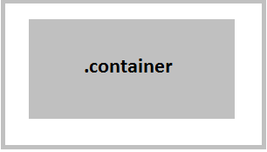

Bootstrap-5 Containers
The container class creates a fixed-width container for your content.
It provides a responsive layout that adjusts its width based on the screen size and available breakpoints.
The container's width is defined using a fixed pixel value, and it maintains a maximum width to prevent excessive stretching on larger screens.
Notes:
Bootstrap-5 Containers
The container class creates a fixed-width container for your content. It provides a responsive layout that adjusts its width based on the screen size and available breakpoints. The container's width is defined using a fixed pixel value, and it maintains a maximum width to prevent excessive stretching on larger screens.

Slide 6
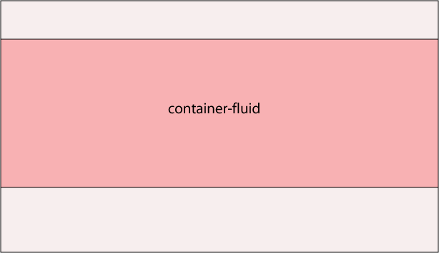
container-fluid
The container-fluid class creates a full-width container that spans the entire width of the viewport.
It provides a responsive layout that adjusts to different screen sizes by filling the available horizontal space.
The container's width is set to 100% of the viewport width, enabling the content to extend to the edges of the screen.
Notes:
container-fluid
The container-fluid class creates a full-width container that spans the entire width of the viewport. The container's width is set to 100% of the viewport width, enabling the content to extend to the edges of the screen. It provides a responsive layout that adjusts to different screen sizes by filling the available horizontal space.

Slide 7
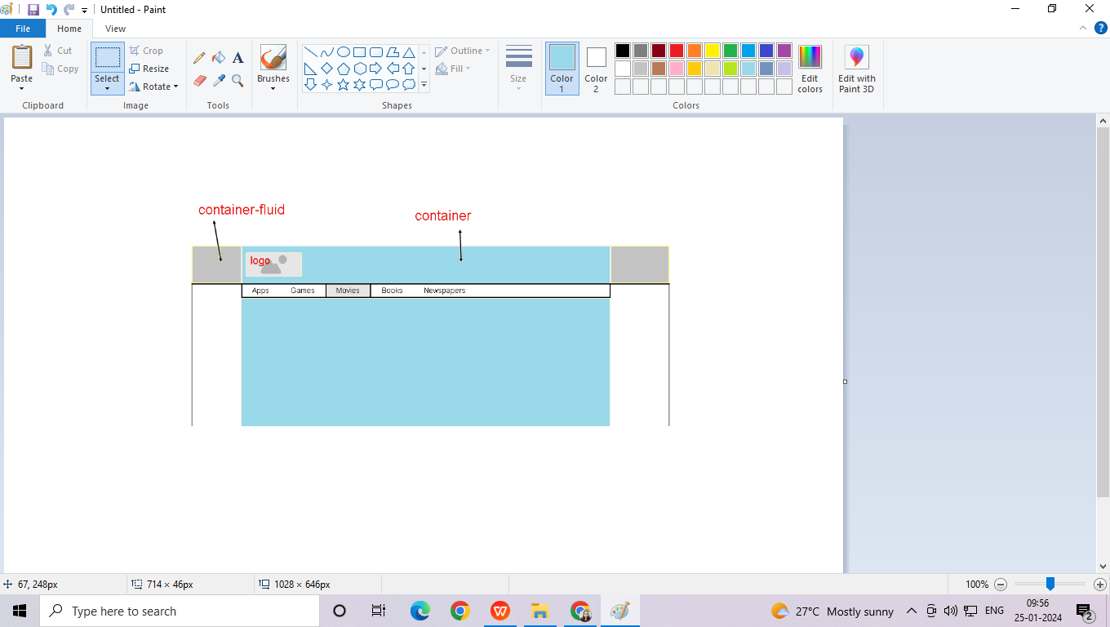
Container & container-fluid
Notes:
container and container fluid are shown here.

Slide 8
Grid System Rules
Rows must be placed within a .container (fixed-width) or .container-fluid (full-width) for proper alignment and padding
Use rows to create horizontal groups of columns
Content should be placed within columns, and only columns may be immediate children of rows
Predefined classes like .row and .col-sm-4 are available for quickly making grid layouts
Notes:
Grid System Rules
Rows must be placed within a .container (fixed-width) or .container-fluid (full-width) for proper alignment and padding. Use rows to create horizontal groups of columns. Content should be placed within columns, and only columns may be immediate children of rows. Predefined classes like .row and .col-sm-4 are available for quickly making grid layouts.

Slide 9

Columns create gutters (gaps between column content) via padding. That padding is offset in rows for the first and last column via negative margin on .rows
Column widths are in percentage, so they are always fluid and sized relative to their parent element
Notes:
Columns create gutters (gaps between column content) via padding. That padding is offset in rows for the first and last column via a negative margin on .rows. Column widths are in percentage, so they are always fluid and sized relative to their parent element

Slide 10

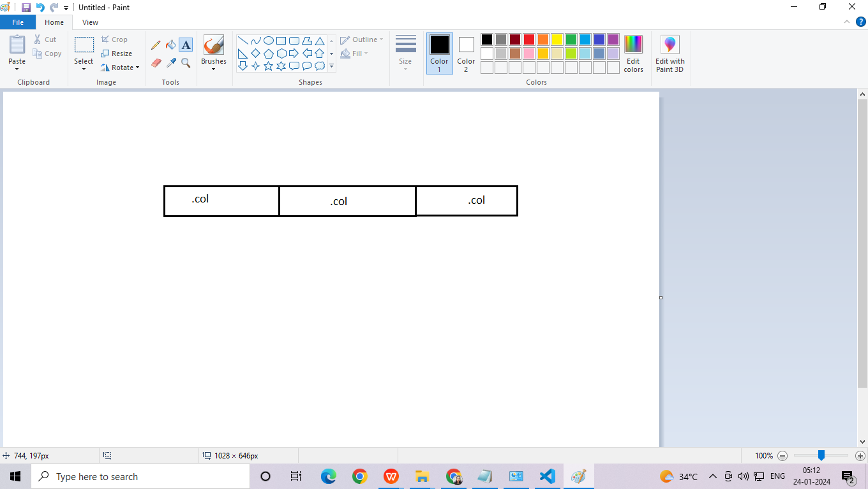
Three equal columns
The following example shows how to create 3 equal width columns, on all devices and screen widths.
<div class="container">
<div class="row">
<div class="col"></div>
<div class="col"></div>
<div class="col"></div>
</div>
Notes:
Three equal columns
The following example shows how to create 3 equal-width columns, on all devices and screen widths. Here is an example of three equal columns using the grid system.

Slide 11
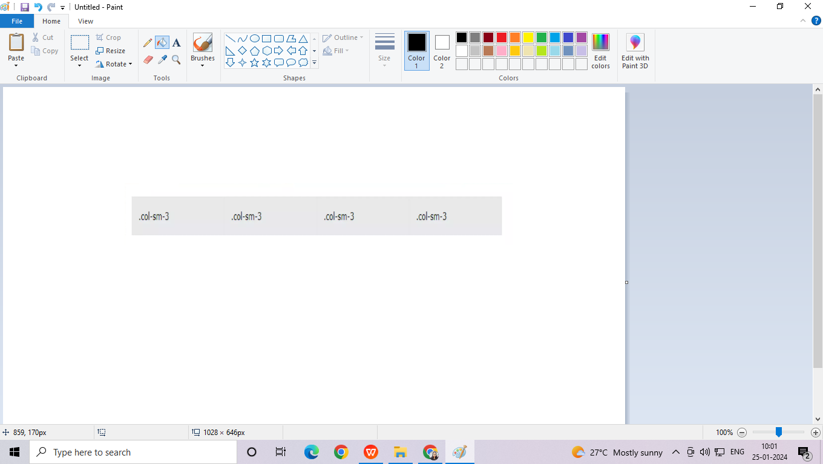
Responsive columns
The following example shows how to create four equal width columns starting at tablets and scaling to extra large desktops.
<div class="container">
<div class="row">
<div class="col-sm-3">col-sm-3</div>
<div class="col-sm-3">col-sm-3</div>
<div class="col-sm-3">col-sm-3</div>
<div class="col-sm-3">col-sm-3</div>
</div></div>
Notes:
Responsive columns
The following example shows how to create four equal-width columns starting at tablets and scaling to extra-large desktops. . Here is an example of responsive columns using the grid system.

Slide 12
2 Unequal Responsive Columns
The following example shows how to get various-width columns.
<div class="row">
<div class="col-sm-4">col-sm-4</div>
<div class="col-sm-8">col-sm-8</div>
</div>
Notes:
2 Unequal Responsive Columns
The following example shows how to get various-width columns. Here is an example of two unequal responsive columns using the grid system.

Slide 13

Basic Structure of a Bootstrap Grid
<div class="container">
<div class="row">
<div class="col-*-*"></div>
<div class="col-*-*"></div>
</div>
<div class="row">
<div class="col-*-*"></div>
<div class="col-*-*"></div>
<div class="col-*-*"></div>
</div>
<div class="row">
...
</div>
</div>
Notes:
This is the example Basic Structure of a Bootstrap Grid

Slide 14

Notes:
Thank you.

